Slide 1


Slide 2
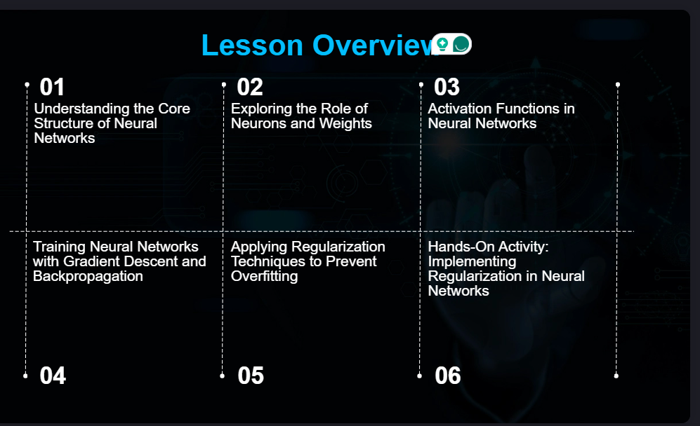

Slide 3


Slide 4
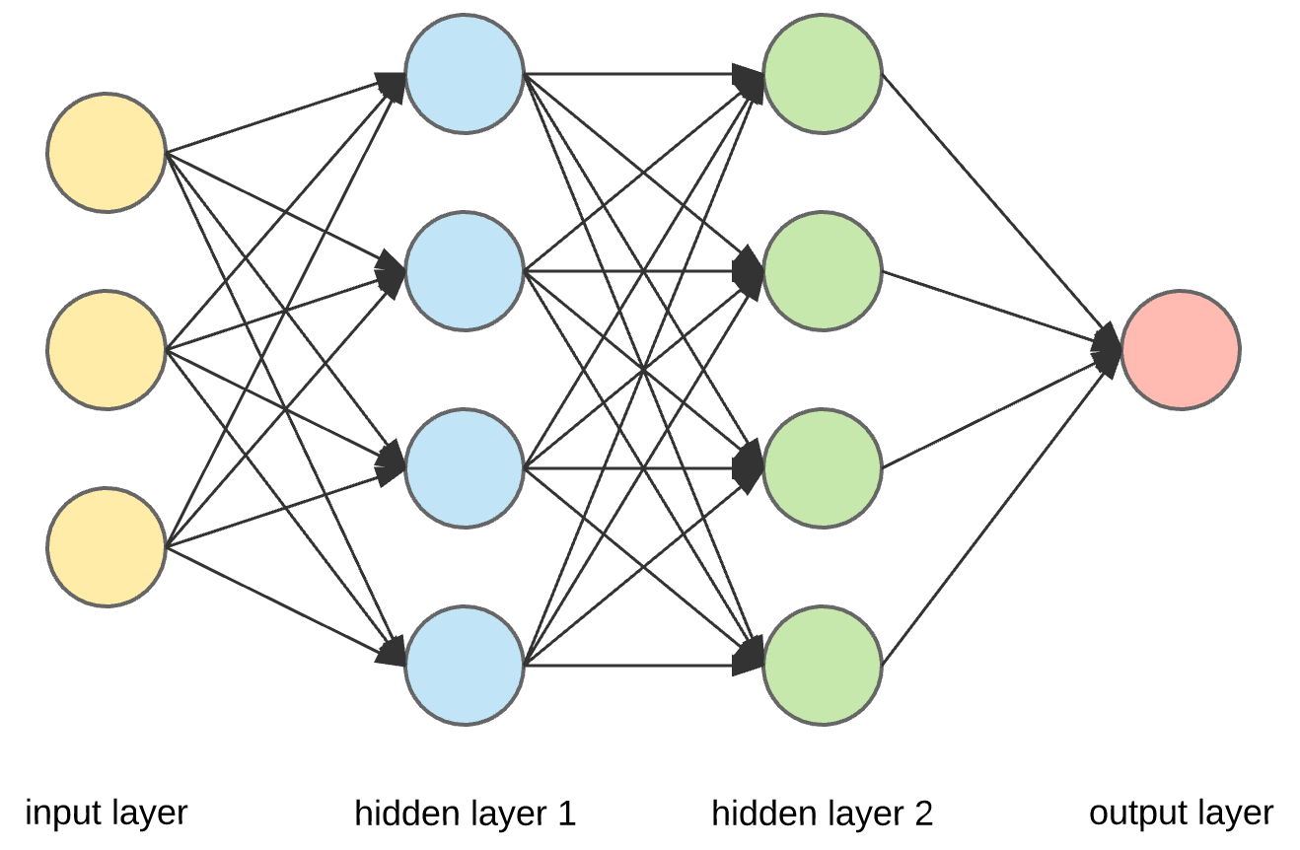

Slide 5
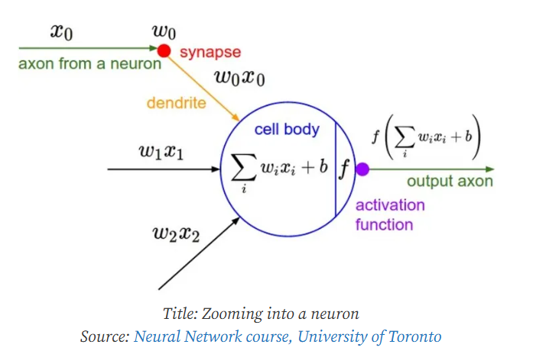
What is being Modeled (a function)?
All or Non
Cumulative influence
Synaptic weight

Slide 6
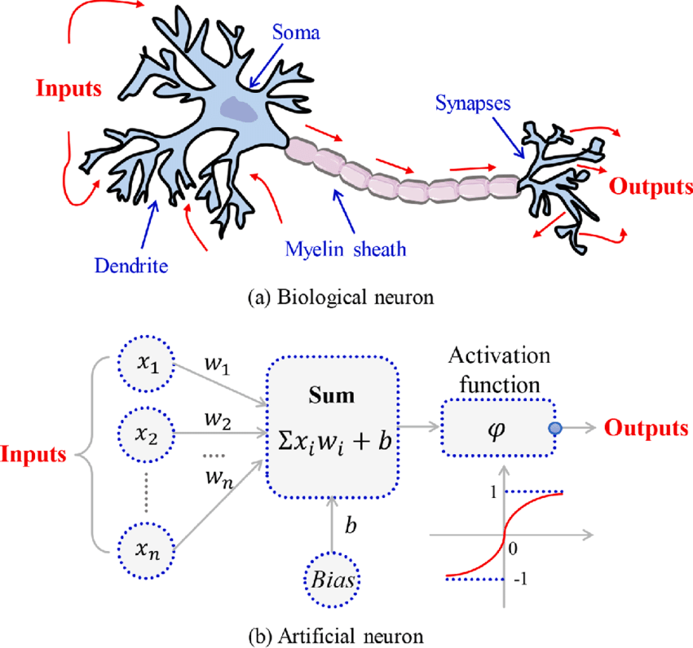

Slide 7
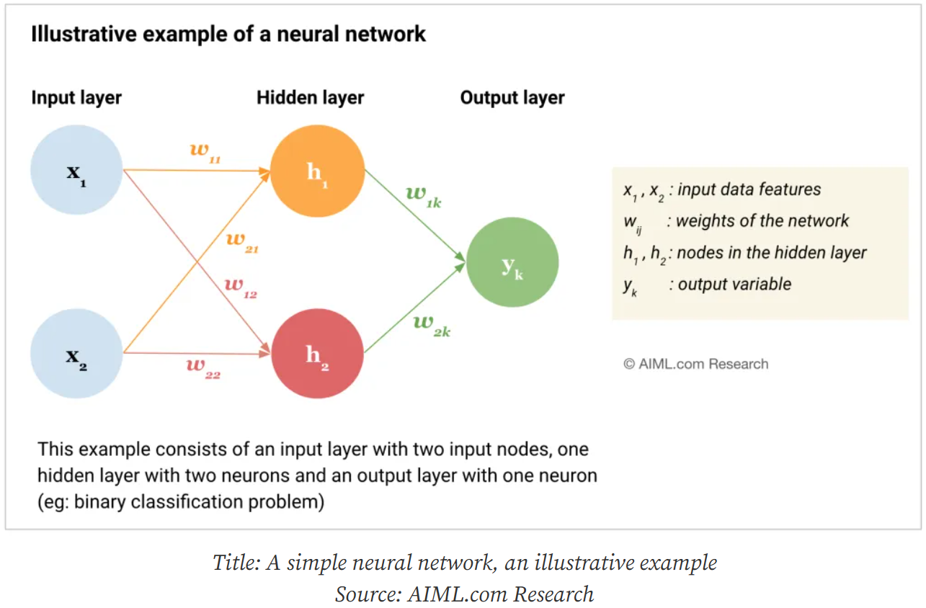

Slide 8
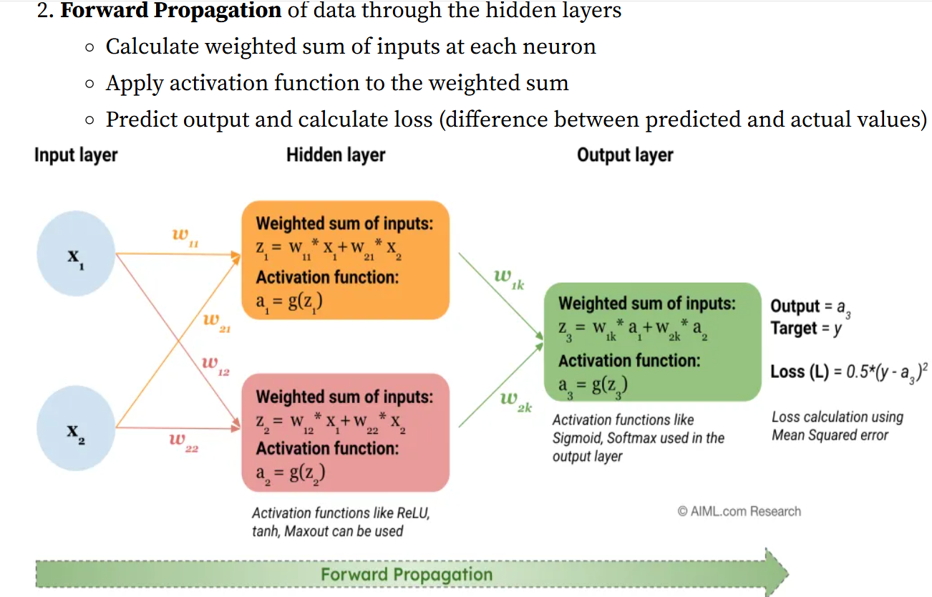

Slide 9
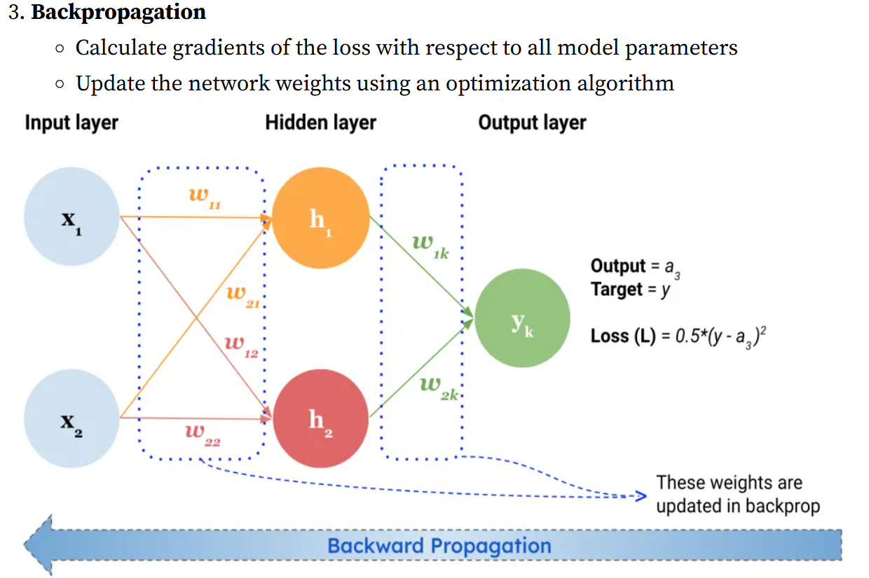

Slide 10
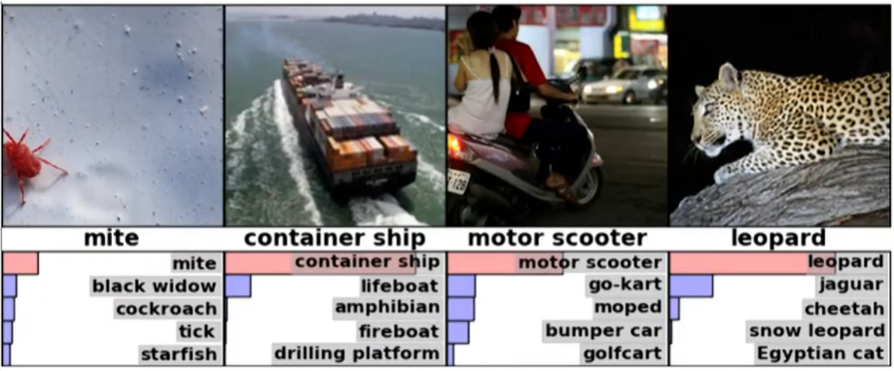
Neural Network model for Detecting objects

Slide 11
Regularization Techniques
Purpose: to prevent overfitting by simplifying the model or reducing its complexity.
Dropout:
technique that randomly turns off a fraction of neurons during training. •
Purpose: Prevents the network from becoming too reliant on specific neurons, encouraging it to generalize better.
L2 Regularization (Ridge Regression) :
adds a penalty term to the loss function, penalizing large weights

Slide 12
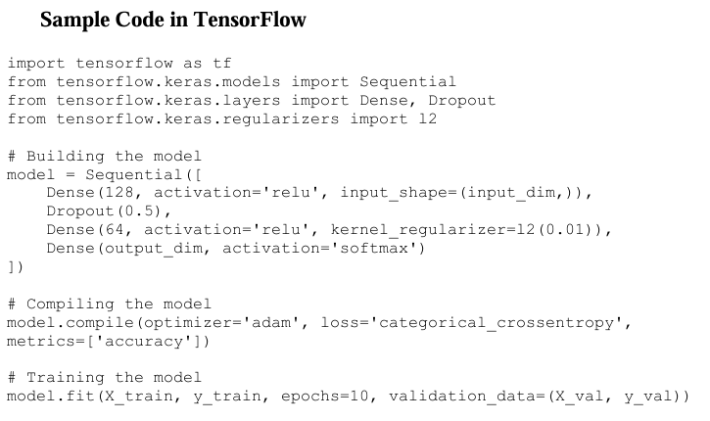
Activity: Applying Regularization Techniques
1. Build a neural network model using TensorFlow or PyTorch.
2. Add a Dropout layer to prevent overfitting.
3. Apply L2 regularization to penalize large weights.
4. Train the model on a dataset and evaluate its performance on unseen data.

Slide 14
https://youtu.be/uXt8qF2Zzfo

